Slide 1
Basic Input/Output

Slide 2
Accessing I/O Devices
Computer system components communicate through an interconnection network
Memory-mapped I/O allows I/O registers to be accessed as memory locations.
As a result, these registers can be accessed using only Load and Store instructions

Slide 3
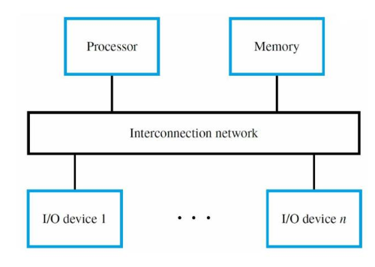
A computer system.

Slide 4
I/O Device Interface
An I/O device interface is a circuit between a device and the interconnection network
Provides the means for data transfer and exchange of status and control information
Includes data, status, and control registers accessible with Load and Store instructions
Memory-mapped I/O enables software to view these registers as locations in memory

Slide 5
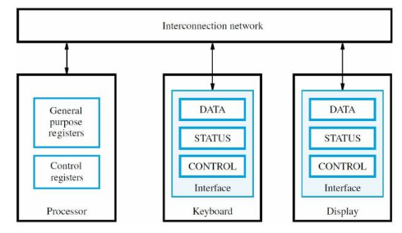
The connection for processor, keyboard, and display.

Slide 6
Program-Controlled I/O
Discuss I/O issues using keyboard & display
Read keyboard characters, store in memory, and display on screen
Implement this task with a program that performs all of the relevant functions
This approach called program-controlled I/O

Slide 7
Signaling Protocol for I/O Devices
Assume that the I/O devices have a way to send a ‘READY’ signal to the processor
For keyboard, it indicates that the character is ready to be read.
For display, it indicates the display is ready to receive the character.
The ‘READY’ signal in each case is a status flag in status register that is polled by processor

Slide 8
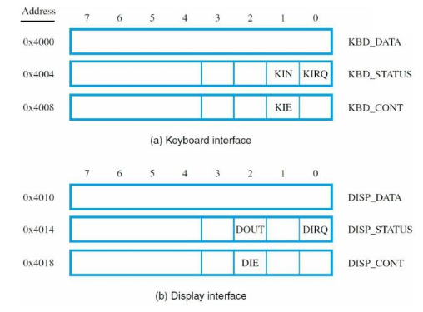

Slide 9
Wait Loop for Polling I/O Status
Program-controlled I/O implemented with a wait loop for polling keyboard status register:
READWAIT:
LoadByte R4, KBD_STATUS
And R4, R4, #2
Branch_if_[R4]=0 READWAIT
LoadByte R5, KBD_DATA
Keyboard circuit places character in KBD_DATA and sets KIN flag in KBD_STATUS
Circuit clears KIN flag when KBD_STATUS read

Slide 10
Wait Loop for Polling I/O Status
Similar wait loop for display device:
WRITEWAIT:
LoadByte R4, DISP_STATUS
And R4, R4, #4
Branch_if_[R4]=0 WRITEWAIT
StoreByte R5, DISP_DATA
Display circuit sets DOUT flag in DISP_STATUS after previous character has been displayed
Circuit automatically clears DOUT flag when DISP_STATUS register is read

Slide 11
RISC- and CISC-style I/O Programs
Consider complete programs that use polling to read, store, and display a line of characters
Each keyboard character echoed to display
Program finishes when carriage return (CR) character is entered on keyboard
LOC is address of first character in stored line
CISC has TestBit, Compare Byte well as auto-increment addressing mode

Slide 12
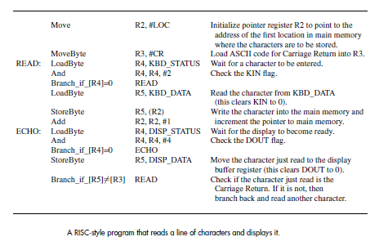

Slide 13
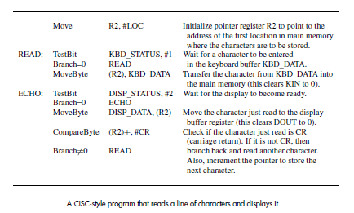

Slide 14
Interrupts
Drawback of a programmed I/O: BUSY-WAIT LOOP
Due to the time needed to poll if I/O device is ready, the processor cannot often perform useful computation
Instead of using a BUSY-WAIT LOOP, let I/O device alert the processor when it is ready
Hardware sends an interrupt-request signal to the processor at the appropriate time, much like a phone call.
Meanwhile, processor performs useful tasks

Slide 15
Example of Using Interrupts
Consider a task with extensive computation and periodic display of current results. Timer circuit can be used for desired interval, with interrupt-request signal to processor
Two software routines: COMPUTE & DISPLAY
Processor suspends COMPUTE execution to execute DISPLAY on interrupt, then returns
DISPLAY is short; time is mostly in COMPUTE

Slide 16
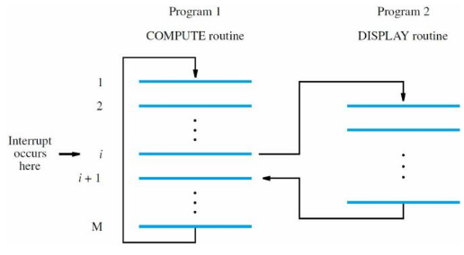

Slide 17
Interrupt-Service Routine
DISPLAY is an interrupt-service routine
Differs from subroutine because it is executed at any time due to interrupt, not due to Call
For example, assume interrupt signal asserted when processor is executing instruction I
Instruction completes, then PC saved to temporary location before executing DISPLAY
Return-from-interrupt instruction in DISPLAY restores PC with address of instruction i + 1

Slide 18
Issues for Handling of Interrupts
Save return address on stack or in a register
Interrupt-acknowledge signal from processor tells device that interrupt has been recognized
In response, device removes interrupt request
Saving/restoring of general-purpose registers can be automatic or program-controlled

Slide 19
Enabling and Disabling Interrupts
Must processor always respond immediately to interrupt requests from I/O devices?
Some tasks cannot tolerate interrupt latency and must be completed without interruption
Need ways to enable and disable interrupts --Provides flexibility to programmers
Use control bits in processor and I/O registers

Slide 20
Event Sequence for an Interrupt
Processor status (PS) register has Interrupt Enable (IE) bit
Program sets IE to 1 to enable interrupts
When an interrupt is recognized, processor saves program counter and status register
IE bit cleared to 0 so that same or other signal does not cause further interruptions
After acknowledging and servicing interrupt, restore saved state, which sets IE to 1 again

Slide 21
Vectored Interrupts
Vectored interrupts reduce service latency; no instructions executed to poll many devices
Let requesting device identify itself directly with a special signal or a unique binary code (like different ringing tones for different callers)
Processor uses info to find address of correct routine in an interrupt-vector table Table lookup is performed by hardware.
Vector table is located at fixed address, but routines can be located anywhere in memory

Slide 22
Interrupt Nesting
Service routines usually execute to completion
To reduce latency, allow interrupt nesting by having service routines set IE bit to 1 Acknowledge the current interrupt request before setting IE bit to prevent infinite loop
For more control, use different priority levels
Current level held in processor status register
Accept requests only from higher-level devices

Slide 23
Simultaneous Requests
Two or more devices request at the same time
Arbitration or priority resolution is required
With software polling of I/O status registers, service order determined by polling order With vectored interrupts, hardware must select only one device to identify itself
Use arbitration circuits that enforce desired priority or fairness across different devices

Slide 24
Controlling I/O Device Behavior
Processor IE bit setting affects all devices
Desirable to have finer control with IE bit for each I/O device in its control register Such a control register also enables selecting the desired mode of operation for the device
Access register with Load/Store instructions
For example interfaces, setting KIE or DIE to 1 enables interrupts from keyboard or display

Slide 25
Processor Control Registers
In addition to a processor status (PS) register, other control registers are often present
IPS register is where PS is automatically saved when an interrupt request is recognized
IENABLE has one bit per device to control if requests from that source are recognized
IPENDING has one bit per device to indicate if interrupt request has not yet been serviced

Slide 26
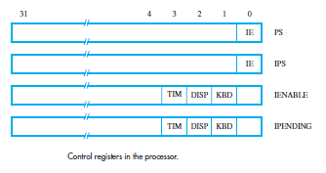

Slide 27
Accessing Control Registers
Use special Move instructions that transfer values to and from general-purpose registers
Transfer pending interrupt requests to R4:
MoveControl R4, IPENDING
Transfer current processor IE setting to R2:
MoveControl R2, PS
Transfer desired bit pattern in R3 to IENABLE:
MoveControl IENABLE, R3

Slide 28
Examples of Interrupt Programs
Use keyboard interrupts to read characters, but polling within service routine for display
Illustrate initialization for interrupt programs, including data variables and control registers
Show saving of registers in service routine
Consider RISC-style and CISC-style programs
We assume that predetermined location ILOC is address of 1st instruction in service routine

Slide 29
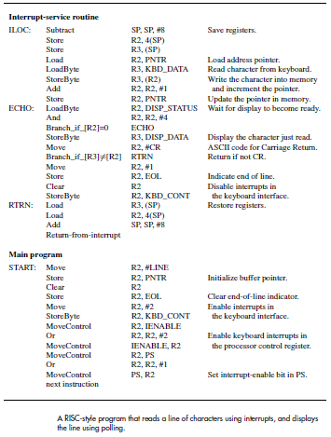

Slide 30
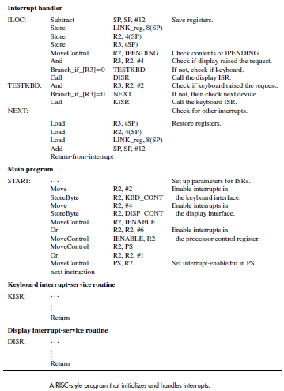

Slide 31
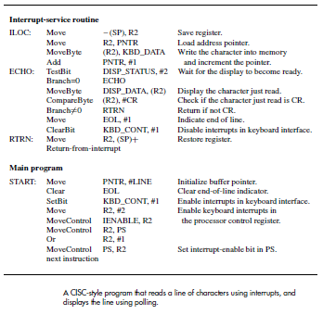

Slide 32
Multiple Interrupt Sources
To use interrupts for both keyboard & display, call subroutines from ILOC service routine
Service routine reads IPENDING register
Checks which device bit(s) is (are) set to determine which subroutine(s) to call
Service routine must save/restore Link register
Also need separate pointer variable to indicate output character for next display interrupt

Slide 33
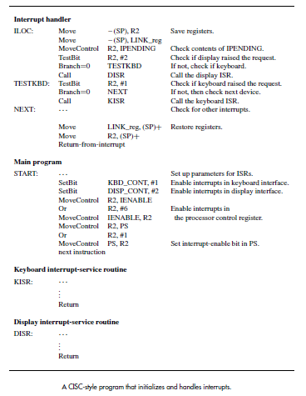

Slide 34
Exceptions
An exception is any interruption of execution
This includes interrupts for I/O transfers
But there are also other types of exceptions
Recovery from errors: detect division by zero, or instruction with an invalid OP code
Debugging: use of trace mode & breakpoints
Operating system: software interrupt to enter

Slide 35
Recovery from Errors
After saving state, service routine is executed
Routine can attempt to recover (if possible)or inform user, perhaps ending execution
With I/O interrupt, instruction being executed at the time of request is allowed to complete
If the instruction is the cause of the exception, service routine must be executed immediately
Thus, return address may need adjustment

